Slide 1
Data Science
Abdelkader Ouared
abdelkader.ouared@univ-tiaret.dz
Tiaret, Algeria

Slide 2
Motivation
Data forms the core of basic processes in most companies.
Data archiving creates organizational memory.
The exploitation of data creates the intelligence of the company
we speak of “economic” or “business” intelligence BI).

Slide 3
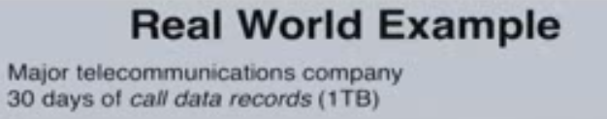
Motivations
Data volume too large, data explosion
How to explore millions of records with thousands of attributes?
Low percentage of analyzed data
Need to respond quickly to opportunities
Need for real-time processing of this data
Traditional queries (SQL) not possible...

Slide 4
Machine Learning Development Process
Machine learning software development requires different approach
compared to traditional software development.
Code-oriented
Traditional Software:
Analysis Design Construction Testing Deployment
Data-oriented
ML Software:
Analysis
Data Collection
Training
Testing
Deployment

Slide 5

Why do we value data?
Improve productivity
Need to make effective strategic decisions
Use historical data to predict the future and anticipate the market
Notes:
Dans quel but valoriser les données?

Slide 6
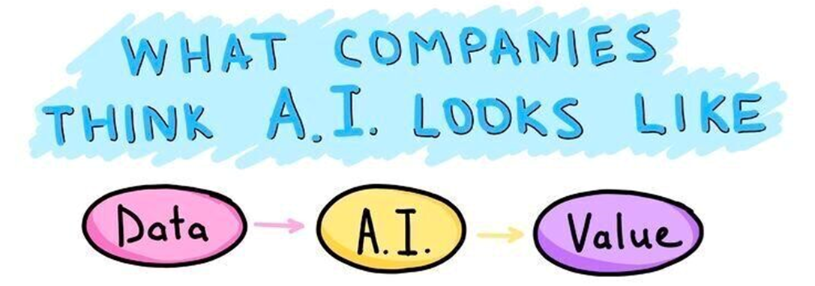
Motivations
?
Data Knowledge
Datamining
Data Science , Machine Learning

Slide 7
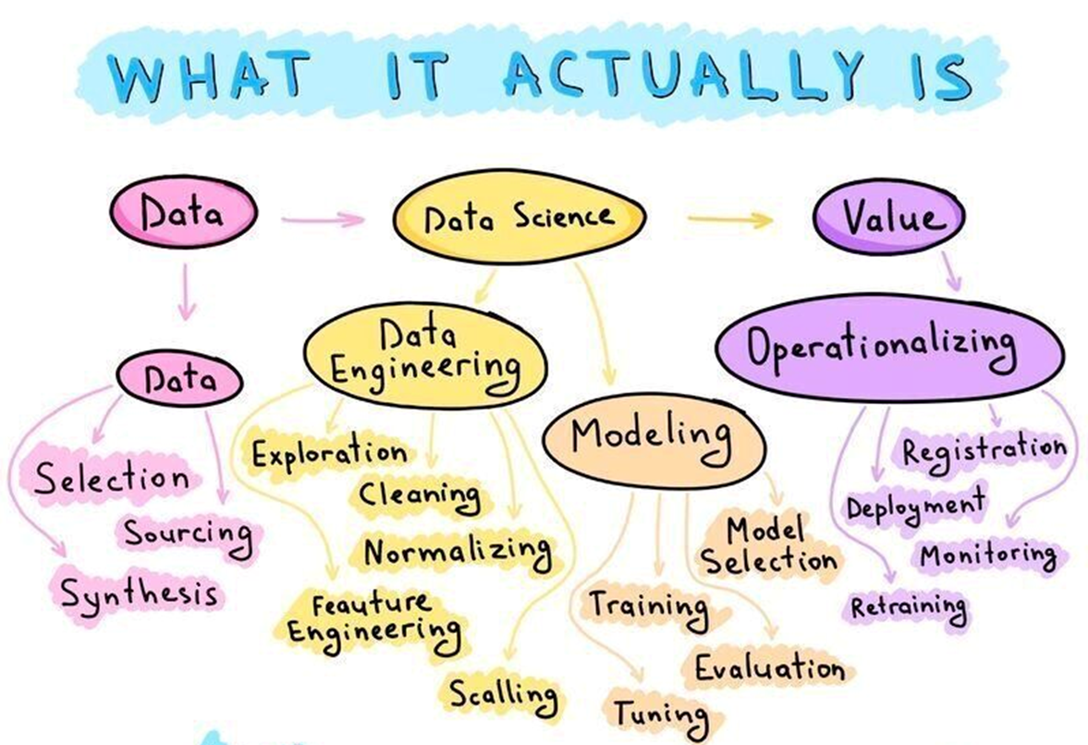

Slide 8
Data Science vs Machine Learning

Slide 9
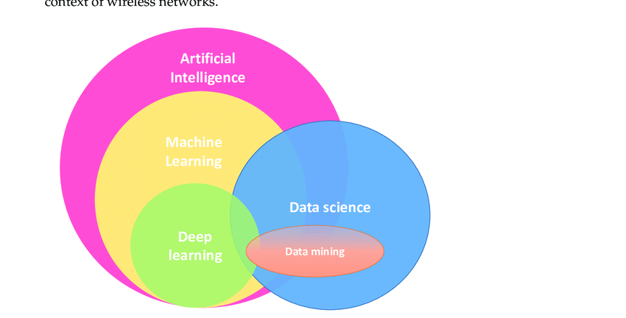
Data science vs. data mining vs. Artificial Intelligence (AI) vs. Machine learning (ML) vs. deep learning.

Slide 10
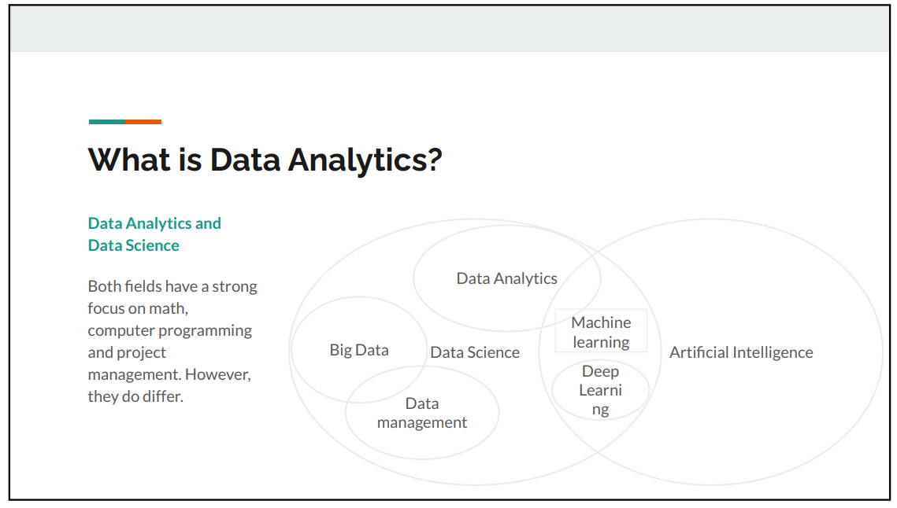

Slide 11
Steps in a machine learning pipeline
Test Data
Model Requirement
Requirements
Analysis
Raw data
Data
Pre processing
Training
Data
Data
Acquisition
Predictive Modeling
Evaluation
Deployment
Problem
Definition
Data Collection
Data Preparation

Slide 12




Steps in a machine learning pipeline
Test Data
Model Requirement
Requirements
Analysis
Raw data
Data
Pre processing
Training
Data
Data
Acquisition
Predictive Modeling
Evaluation
Deployment
Roles
Data Scientist
Domain Expert
(Data) Engineer

Slide 13
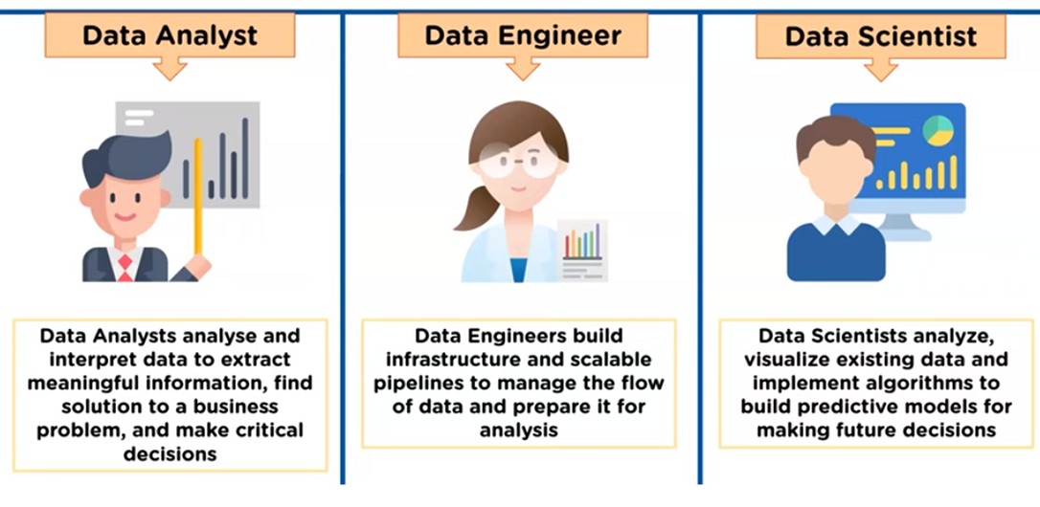
Data Analyst vs Data Scientist vs Data Engineer -Who Are They?

Slide 14
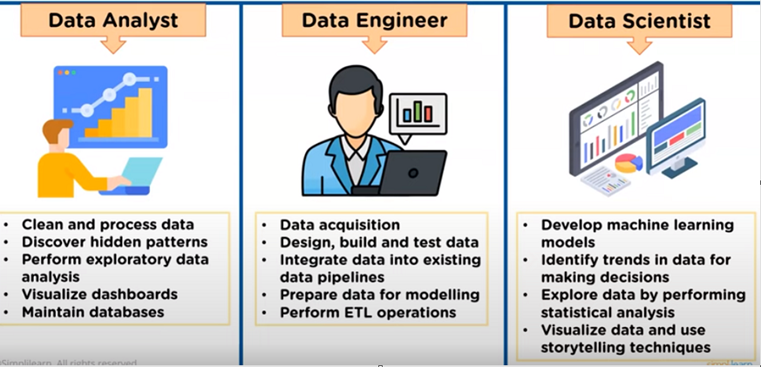
Data Analyst vs Data Scientist vs Data Engineer -Responsabilities

Slide 15
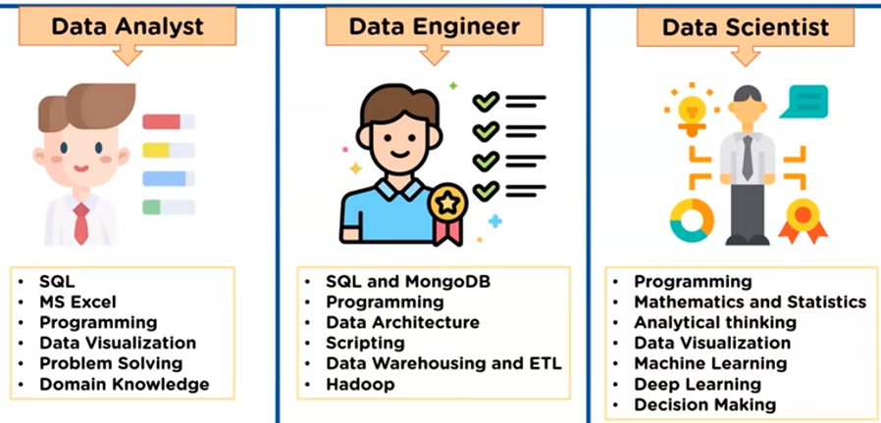
Data Analyst vs Data Scientist vs Data Engineer -Skills

Slide 16
Example of applications

Slide 17
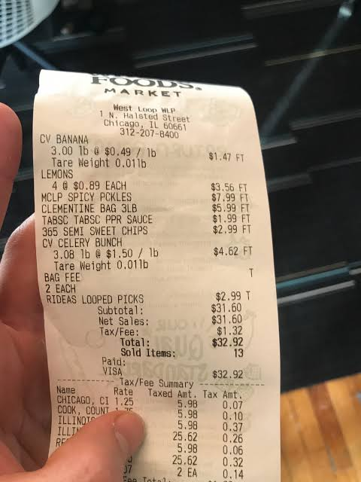



Example of applications
+

Slide 18



Example of applications
Telecom domain
Solution: Three months before the expiry of the contract, predict the customers who will leave
"If you want to keep them, offer a new phone."
Problem: Renewal rate (at the end of the contract) is 25% !!!

Slide 19
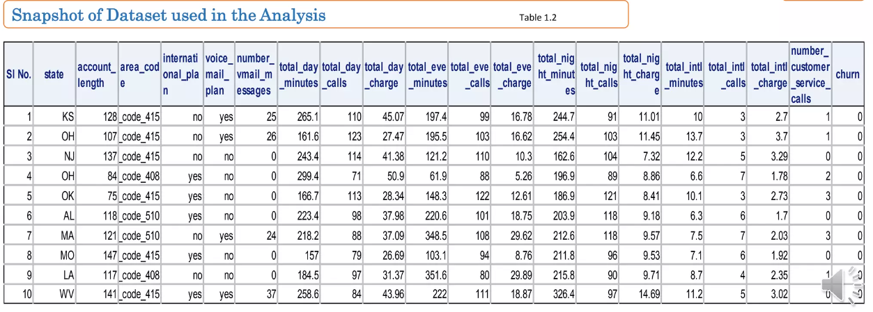
Example of applications
Telecom domain

Slide 20

Dataset ??
https://www.kaggle.com/
https://datasetsearch.research.google.com/
Réseaux Sociaux et Textes
Twitter API: https://developer.x.com/en/docs

Slide 21

تحليل الاتجاهات في البيانات الاجتماعية الضخمة Opinion Mining in Social Big Data
سبب إمتناع الأفراد على أخذ اللقاح!!
عدم الثقة <
الرغبة في الاختيار <
النص : التغريدات ومشاركات فيسبوك
+
اشتقاق معلومات الشخص

Slide 22


تحليل الاتجاهات في البيانات الاجتماعية الضخمة Opinion Mining in Social Big Data
تغيير فوري لسياسة المبيعات
التغريدات والآراء

Slide 23










تحليل الاتجاهات في البيانات الاجتماعية الضخمة Opinion Mining in Social Big Data
تسيير الحملة الانتخابية
تحليلات وصفية
خصائص المناطق
كيف يمكن تحديد المناطق التي فيها قبول ؟
التحليلات التنبؤية
الردود والتعليقات على المنشورات
ماذا قد يحدث؟
التحليلات الوقائية
ماذا علينا ان نفعل؟

Slide 24

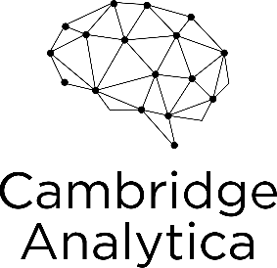




تحليل الاتجاهات في البيانات الاجتماعية الضخمة Opinion Mining in Social Big Data
استعمال الاعلانات بطريقة ذكية
اختبار معرفة نوع الشخصية
بيانات 87 مليون شخص
الفوز في الانتخابات

Slide 25
The ideal tool for data scientists ?
Data Scientist
managing data
Cleaning data
Analyzing data
Modeling data
Organizing the results of the analysis into a form suitable for plotting or tabular display

Slide 26
Python Libraries for Data Science (or Scientific Python packages)
Many popular Python toolboxes/libraries:
Numerical
○ NumPy
○ SciPy
○ Pandas
Machine Learning
○ SciKit-Learn (sklearn)
Visualization libraries (Graphics)
○ matplotlib
○ Seaborn
and many more …
Databases
○ pyodbc
○ psycopg2 PosgreSQL
○ MySQLdb MySQL
○ cx_oracle Oracle
○ ibm_db
○ pymssql SQL Server
Link: http://www.numpy.org/
Link: https://www.scipy.org/scipylib/
Link: http://scikit-learn.org/
Link: https://seaborn.pydata.org/
Link: https://matplotlib.org/

Slide 27


Steps in a machine learning pipeline
Data Collection
Test Data
Model Requirement
Raw data
Data
Pre processing
Training
Data
Identify a problem
Defining the objective
Determine the type of data
Set a plan for collecting the data
Decide data sources
Select collection methods
Develop data collection instruments
Requirements
Analysis
Data
Acquisition
Predictive Modeling
Evaluation
Deployment
Roles
Data Scientist
Domain Expert
(Data) Engineer

Slide 28
Data Collection for Data Science: Step-by-Step
Domain Expert
(Data) Engineer

Slide 29
Good Data Scientists don’t gather project requirements. They dig for them
“Requirements rarely lie on the surface”
The majority of Data Science projects fail. I will not even provide any references in support of this statement — the Internet is full of examples. The reasons for the high failure rate are many and varied. However, as surprising as this may sound, one of the main reasons is the lack of clearly defined project goal(s) and the associated requirements.
Problem understanding and requirements gathering make up an initial phase in pretty much any project management framework, including the widely used “Cross-Industry Standard Process for Data Mining” (CRISP-DM). This implies that the project goals and requirements are already there, waiting to be “gathered”. However, as Andrew Hunt and David Thomas say in their famous book “The Pragmatic Programmer”:
“It doesn’t quite work that way. Requirements rarely lie on the surface. Normally, they’re buried deep beneath layers of assumptions, misconceptions, and politics.”

Slide 30
Steps in a machine learning pipeline
Data Collection
Test Data
Model Requirement
Raw data
Data
Pre processing
Training
Data
Identify a problem
Defining the objective
Determine the type of data
Set a plan for collecting the data
Decide data sources
Select collection methods
Develop data collection instruments
Requirements
Analysis
Data
Acquisition
Predictive Modeling
Evaluation
Deployment
Roles
Data Scientist
Domain Expert
(Data) Engineer

Slide 31
Complete Guide to Data Collection for Data Science
Did you know that data collection is one of the most time-consuming steps in the process of data science? But it's definitely not as terrifying as data cleaning.
The explosion in data production is making all organizations more data-driven.
Collecting data is the new trend in the market and this post is an informative piece on everything you should know about data collection.

Slide 32
What is data collection in data science?
Data collection is the process of accumulating data that's required to solve a problem statement.
What do I mean by a problem statement?
All data science projects (all projects really) start with a problem that needs a solution. There's always something you can solve or improve.

Slide 33
Step-by-step guide to data collection
Data collection gets done in steps, and it's important to understand that this is an iterative and repetitive process, meaning that after the first round of collecting data, you probably need to repeat what you did.
In the below sections, you can read about the steps you can take to collect your data.

Slide 34
Step-by-step guide to data collection
Identify a problem statement/ Defining the objective : identify a business or research issue, and set goals for the project
Determine what type of data is needed
Set a plan for collecting the data, including
Decide on your data sources
Select data collection methods
Develop data collection instruments
Collect your data

Slide 35
Lab: Project DataScience

Slide 36
Brainstorming Session
Prerequisite: groups of 4-5 students formed
Guidelines about: – How to structure your data analytics project using the Open Data Canvas ? – How to take an user-centered perspective ? – How to brainstorm for an innovative open data analytics idea ? – Which tools to exploit in order to develop your project ? – How to pitch your idea?
You receive feedback and coaching about your preliminary ideas

Slide 37
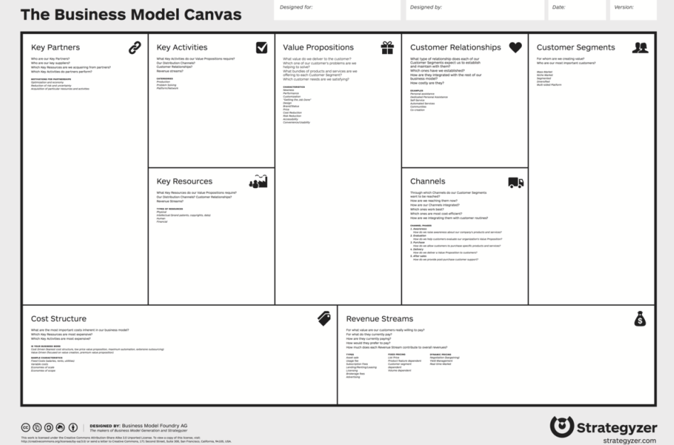
Business Model Canvas … again

Slide 38
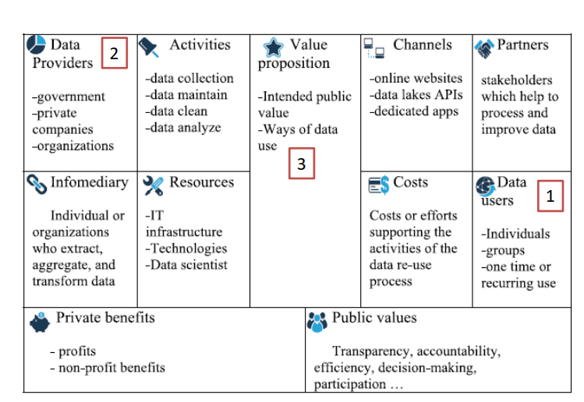
Where to start ? Open Data Canvas

Slide 39

1) Data Providers:

Slide 40
2) Data Users:
Ask yourself who are the users of the solution you are developing? – Who are they? – What are their roles? – What are their goals?

Slide 41
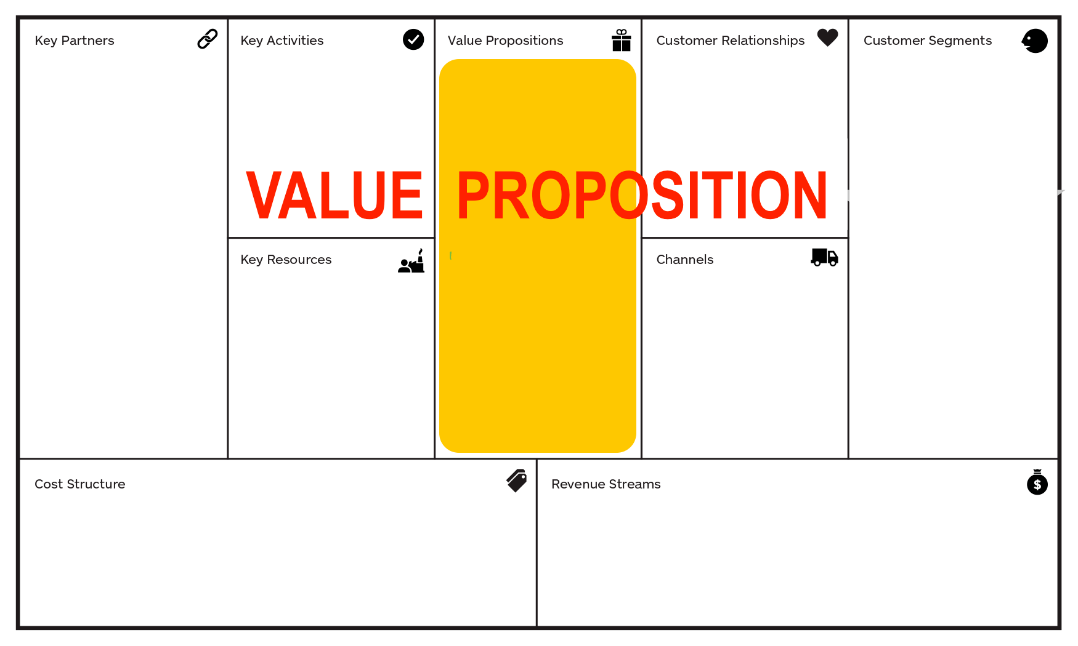
3) Value Propositions: Project Data Science

Slide 42
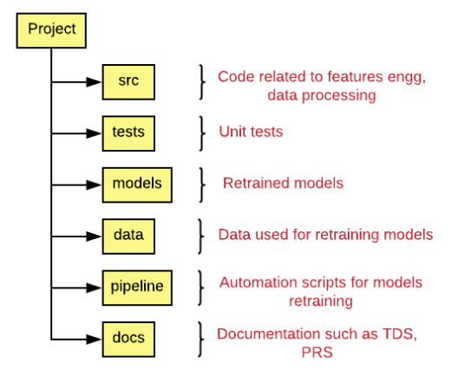
Data Science Code structure

Slide 43
Data Preprocessing

Slide 44
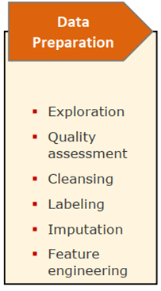
Steps in a machine learning pipeline
Test Data
Model Requirement
Requirements
Analysis
Raw data
Data
Pre processing
Training
Data
Data
Acquisition
Predictive Modeling
Evaluation
Deployment
Roles
Data Scientist
Domain Expert
(Data) Engineer

Slide 45
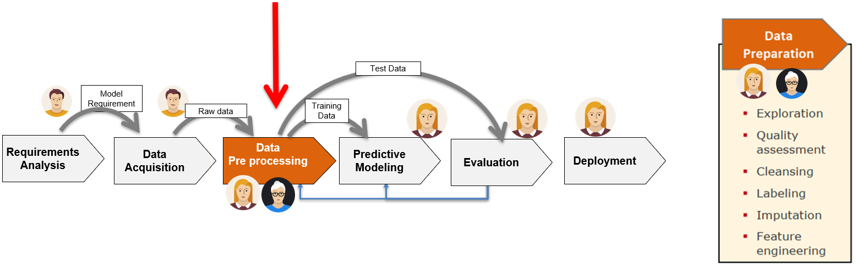
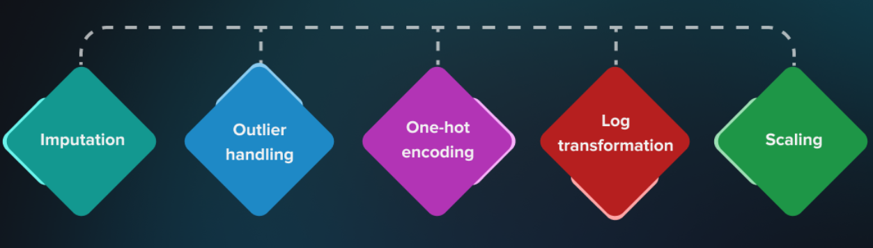
Data Preprocessing

Slide 46
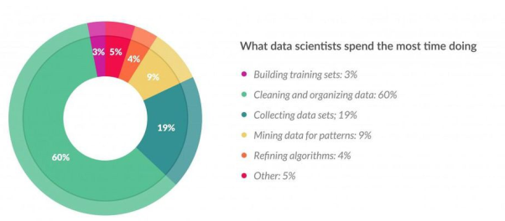
Data Preparation Importance -Motivation

Slide 47
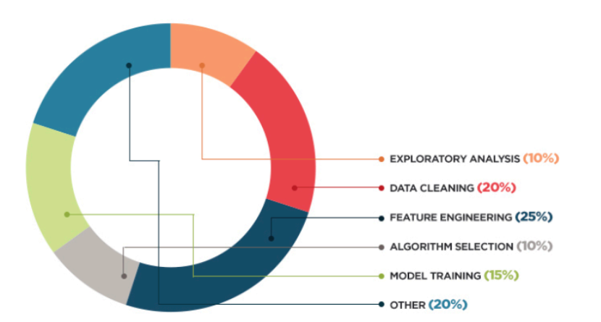
Feature Engineering!
Data scientists usually spend the most time on feature engineering!

Slide 48
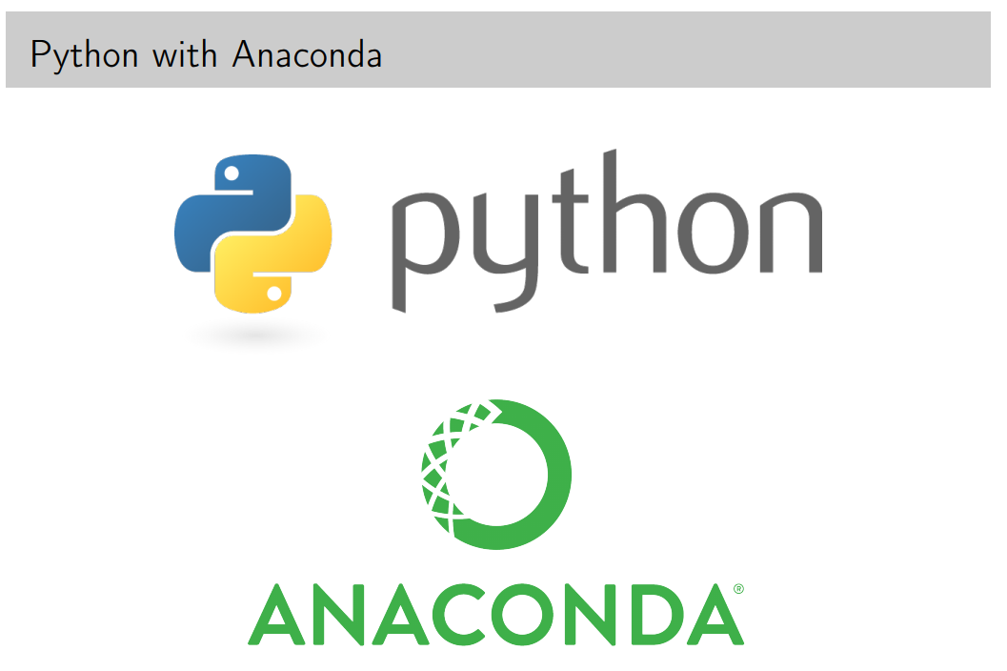
Some of the popular libraries used for data preprocessing in Python
Pandas
NumPy
Matplotlib
Seaborn

Slide 49

Programming Language
Level
of
Abstraction
C++, Java, Python
Fortran,C
assembly
time
machine code

Slide 50





Why Python ?
REASONS
Multi purpose language
Data Analysis
Mobile Apps
High-level
Huge Community
Cross-platform
Large Ecosystem
AI /ML
Desktop Apps
Automation
Testing
Web Apps
IOT
www.python.org

Slide 51
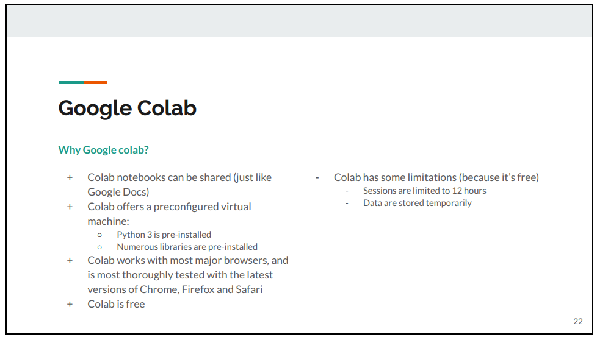

Slide 52
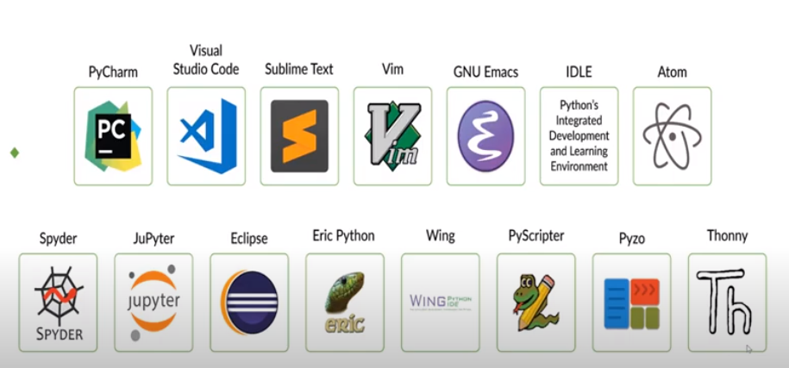
Python IDEs

Slide 53
Which version of Windows operating system that you are installed ?

Slide 54
Anaconda
Anaconda est un outil dont la distribution est libre et open source. Il est destiné à la programmation dans un environnement Python et R. Anaconda est largement utilisé en sciences de données, en intelligence artificielle ou Machine Learning.
Installer et Configurer Anaconda

Slide 55
Download Anaconda
First, go to https://www.anaconda.com/products/distribution to download the latest version of Anaconda. If the link has changed, you can easily find the updated one using Google.

Slide 56
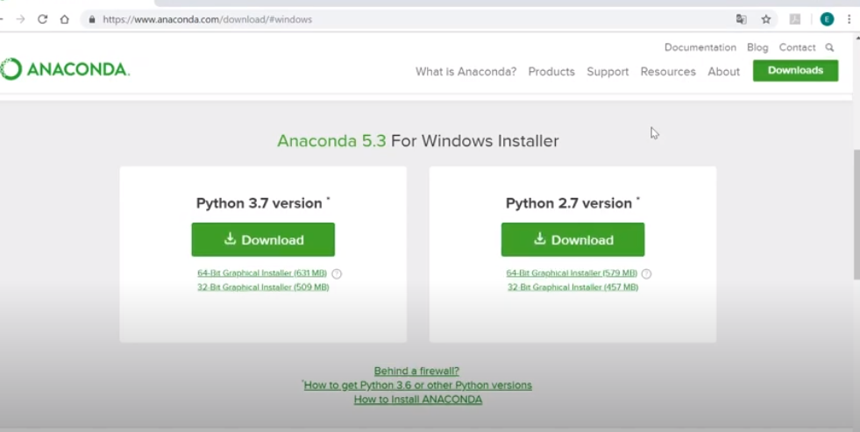
Download Anaconda Distribution

Slide 57
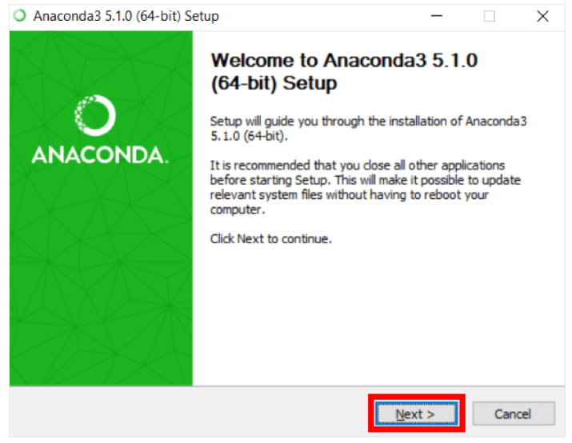
Step 1

Slide 58
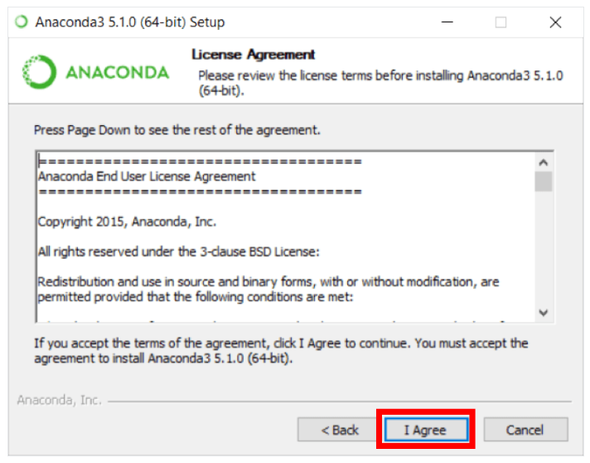
Step 2

Slide 59
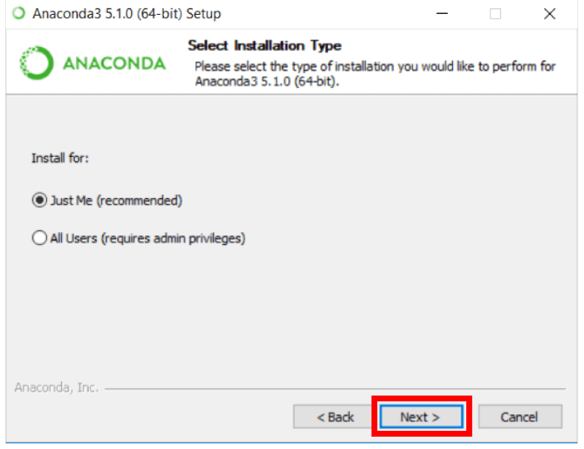
Step 3

Slide 60
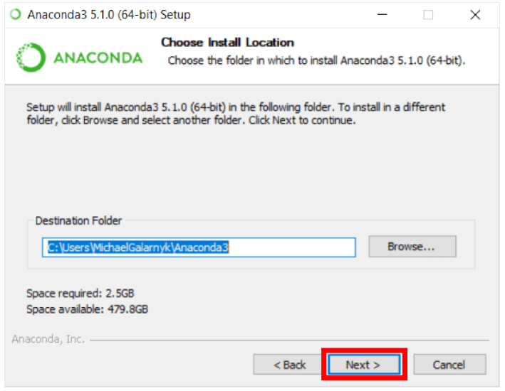
Step 4

Slide 61
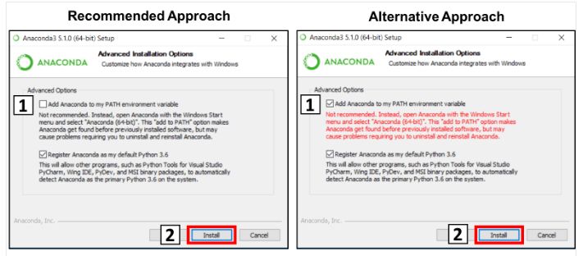
Step 5

Slide 62
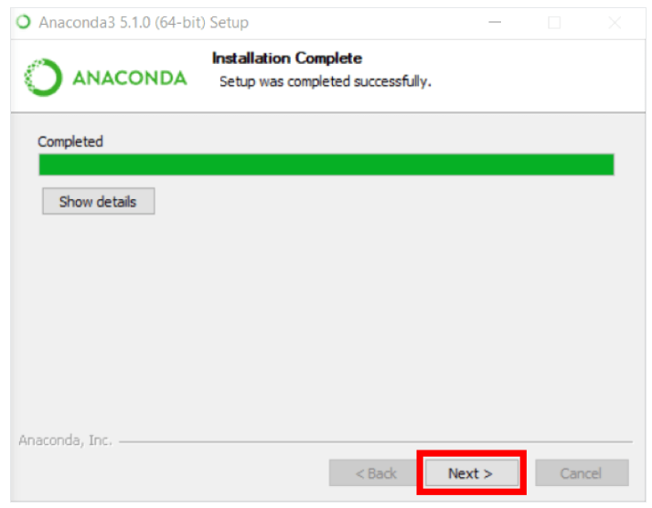
Step 6

Slide 63
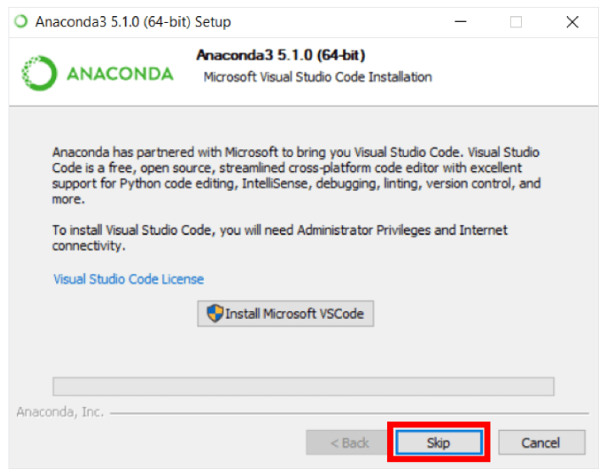
Step 7

Slide 64
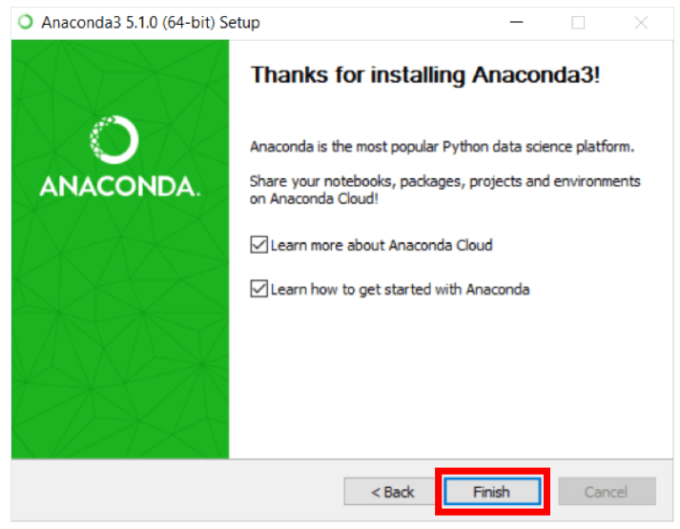
Step 8

Slide 65
Testing if Python is installed on Windows
Open the Command Prompt in Windows (Win +R: cmd)
python –version
python “path of the python file”
conda –version
conda update conda
conda install numpy,
conda install pandas
conda install matplolib
conda install seaborn

Slide 66

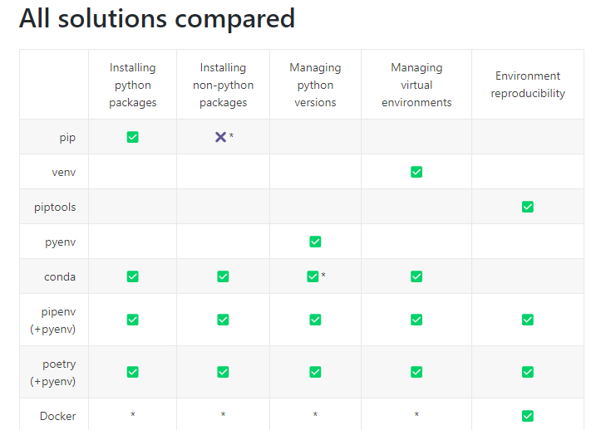
Anaconda Configuration
Overview of python dependency management tools (package manager)
Point of Difference | pip | Conda
Multi-Language Dependency | Not Supported | Supported
Package Installation | Build on wheels | Download binary
Package Availability | 235,000 packages | 1,500+ pacakges
Dependency Management | No SAT test | performs SAT test
Virtual Environment Management | No in-built Virutal management | In-built virtual management system
Package format | .whl, .tar .gz | .tar .bz2, conda
Package types | Python-only | Any
Default package source | PyPy Cloud (repo) | Anaconda Cloud (repo)
Can require local compiler | Yes | No
Dependecy checks | No | yes

Slide 67
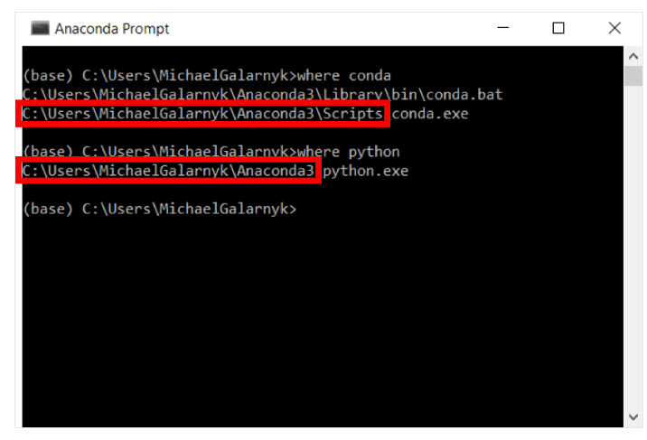
How to Add Anaconda to Path (Optional) ?
This is an optional step. This is for the case where you didn't check the box in step 6 and now want to add Anaconda to your Path. The advantage of this is that you will be able to use Anaconda in your Command Prompt, Git Bash, cmder etc.
1. Open a Command Prompt.
where python
Where conda
2. Win+R: systempropertiesadvanced
Add anaconda & conda to path
Notes:
Les variables d’environnement de Windows définissent certaines données de configuration qui peuvent être utilisées par les applications et Windows lui même.

Slide 68
Install Python Packages with pip and conda
Install and Manage Packages in Python
pip | conda
pip search pyserial | conda search pyserial
pip install pyserial | conda install pyserial
pip install pyserial –upgrade | conda update python
pip list | conda list
pip --version | conda -- version
pip -help | conda install pip

Slide 69

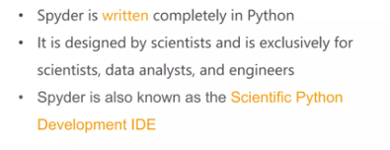
Spyder
What is Spyder?
Features of Spyder
Python Spyder IDE Installation
Greating a File/Project
Writing the Code
Variable Explorer
File Explorer
Configuring Spyder
Help

Slide 70
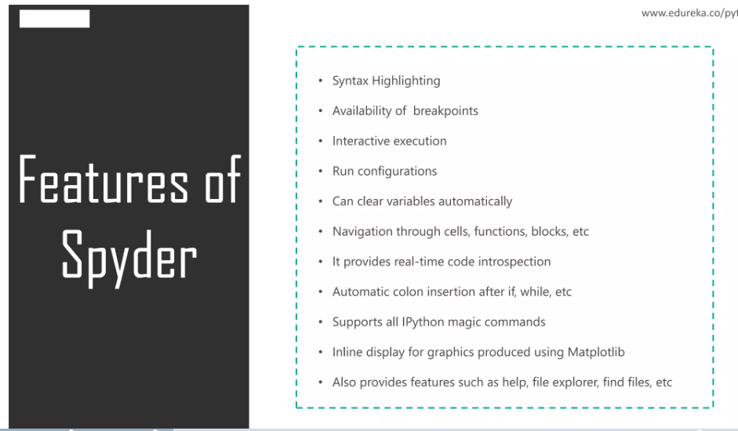
Features of Spyder

Slide 71
Example
import sys
print("User Current Version:-", sys.version)

Slide 72
Example
sms = input("Hello world: ")
print(sms)

Slide 73
Example
for x in range(1,11):
print(x**2)

Slide 74
Example
try:
import matplotlib
except:
import pip
pip.main(['install','matplotlib'])
import matplotlib

Slide 75
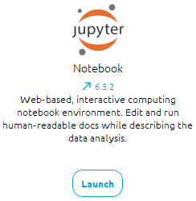
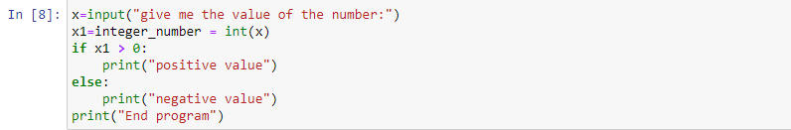
Jupyter Notebook

Slide 76
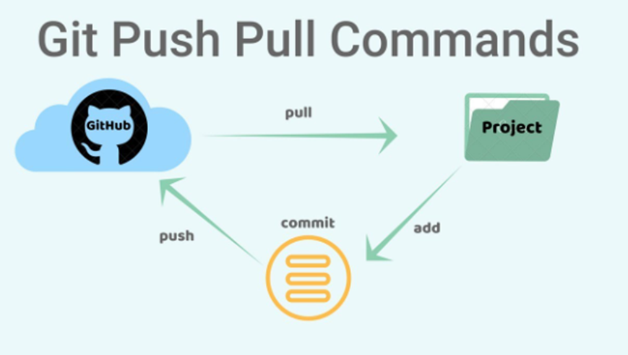
Using Git and GitHub

Slide 77



Using Git and GitHub
Create an Account on GitHub
https://github.com/
Installing Git
https://git-scm.com/
Installing TortoiseGit on Windows
https://tortoisegit.org/

Slide 78
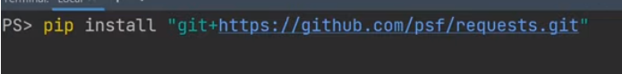
PIP Install Git – A quick read
Git Installation
git --version

Slide 79
PIP Install Git – A quick read
Git Installation
git --version

Slide 80
Some of the popular libraries used for data preprocessing in Python
Pandas
NumPy
Matplotlib
Seaborn
Install Anaconda ☺

Slide 81
Pandas

Slide 82
Pandas
Powerful data analysis and manipulation tool
Adds data structures and tools designed to work with table-like data (similar to Series and Data Frames in R)
Provides tools for data manipulation: reshaping, merging, sorting, slicing, aggregation etc.
Allows handling missing data

Slide 83



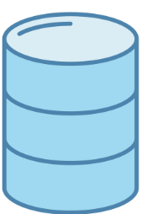
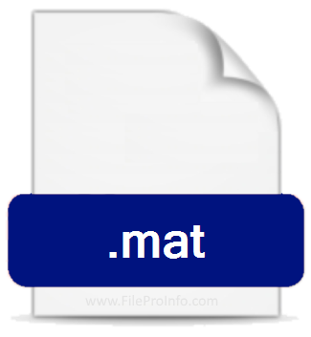
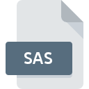



File formats
Importing Data in Python
Text Files
Excel Spreadsheets
Stata Files
SAS Files
Relational Databases
Matlab Files
Pickled Files
HDF5 Files
- CSV is a common format for data interchange
- Many online services/applications allow to export tabular data into a CSV file.
All databases have a tool to allow import from CSV file.
Files of CSV will open into Excel, Notepad or any simple text editors

Slide 84
Lab Pandas

Slide 85
Import data
import pandas as pd
import matplotlib.pyplot as plt
#Read in data downloaded to the local directory
data = pd.read_csv("Train_v2.csv")

Slide 86
Display information about the data
#just to check you imported the dataset properly
print(data.head(n=5))
#secondary check on the size of the dataframe
data.info()
data.shape

Slide 87
Descriptive statistics
data.describe()
Also: count, sum, median, min, max, abs, prod, std, var, skew, kurt, quantile, cumsum, cumprod, cummax, cummin

Slide 88
Delete a column
# Delete a column
del df['column_name']
df.drop('column_name', axis=1)
pop('column_name')
# Drop duplicates
df.drop_duplicates()

Slide 89
Change the order of the columns
target = data["bank_account"]
data = data.drop(["bank_account"], axis = 1)
data["bank_account"] = target
bank_account

Slide 90
Sorting
# Sorting
df.sort_values(by='column_name’)
df.sort_values(by='age')
newdf = df.sort_values(by='age',inplace=True, kind='quicksort',ascending=False)
# error change inplace=True with inplace =False
newdf = df.sort_values(by='age',inplace=False, kind='quicksort',ascending=False)

Slide 91
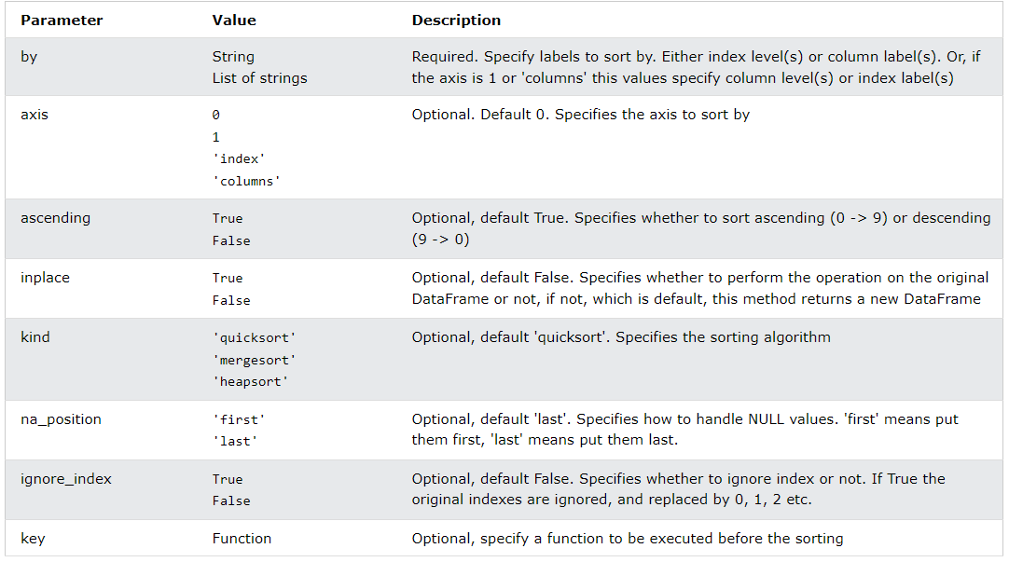
Sorting with more details
Syntax
dataframe.sort_values(by, axis, ascending, inplace, kind, na_position, ignore_index, key)
Parameters

Slide 92
Querying
# Querying
df['column_name'].where(df['column_name'] > 50)
Also: you can use loc and iloc

Slide 93
Missing Values
There are a number of methods to deal with missing values in the data frame:
df.method() | description
dropna() | Drop missing observations
dropna(how='all') | Drop observations where all cells is NA
dropna(axis=1, how='all') | Drop column if all the values are missing
dropna(thresh = 5) | Drop rows that contain less than 5 non-missing values
fillna(0) | Replace missing values with zeros
isnull() | returns True if the value is missing
notnull() | Returns True for non-missing values

Slide 94
Checking if there are NAs
df.isnull().any() # series
df.isnull().values.any() # bool
missing_values= pd.DataFrame(df.isnull().sum(), columns=['Missing Values’]) # number of missing values
missing=data[df.isnull().any(axis=1)] # Detecting the NAN values indexes

Slide 95
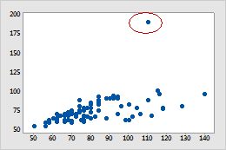
Removing Indexes with Outlier Values

Slide 96
How to plot a scatter plot with matplotlib?
plt.scatter(x = dataframe.index, y = dataframe.value)
import matplotlib.pyplot as plt
data = pd.read_csv("Data.csv")
plt.scatter(data.index, data.household_size)
plt.xlabel("index")
plt.ylabel("household_size")
plt.show()

Slide 97
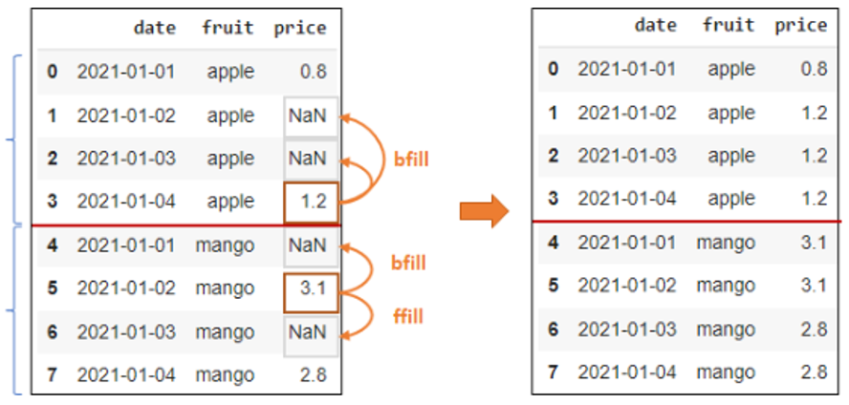
fill missing Values
Apple
Group
Mango
Group

Slide 98
fill missing Values
# Data filling
df['column_name'].fillna('some_values’)
DataFrame.fillna(value=None, *, method=None, axis=None, inplace=False, limit=None, downcast=None)
Notes:
Fill-anay (fill)

Slide 99
fill missing Values
Fill with Constant Value
df['price'].fillna(value = 0.85, inplace = True)
Fill with Mean / Median of Column
# mean
df['price'].fillna(value = df.price.mean(), inplace = True)
# median
df['price'].fillna(value = df.price.median(), inplace = True)

Slide 100
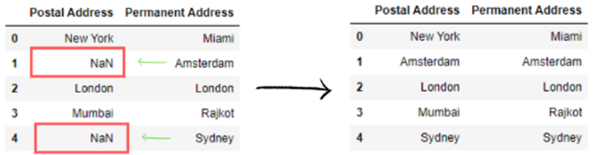
fill missing Values (Fillna (Fill NA/NaN))
# fill missing values
df['Postal Address'].fillna(df['Permanent Address'], inplace=True)
print(df)

Slide 101
Iterate through each row and and select data
for ind in df.index:
print(df['Name'][ind], df['Age'][ind])
for i in range(len(df)):
print(df.loc[i, "Name"], df.loc[i, "Age"])
for i in range(len(df)):
print(df.iloc[i, 0], df.iloc[i, 2])

Slide 102
Does the data is imbalanced??
count_classes = pd.value_counts(data['bank_account'], sort = True)
print(count_classes)
import matplotlib.pyplot as plt
count_classes.plot(kind = 'bar', rot=0)
LABELS = ["Bank_account","Non_bank_account"]
plt.xticks(range(2), LABELS)
plt.title("Frequency by observation number")
plt.xlabel("bank_account")
plt.ylabel("Number of Observations")

Slide 103
Row Selection from DataFrame
#by row label
print(df.loc['a’])
#by using row integer row location
print(df.iloc[4])
#by using slice operator :
print(df[0:3])

Slide 104
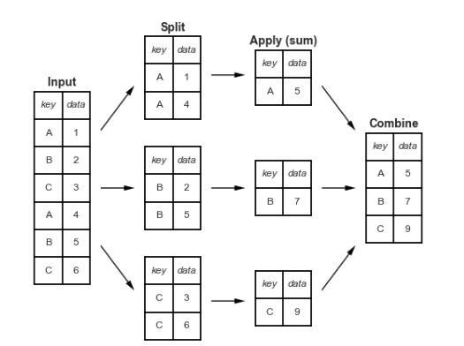
Group By (Split, apply, combine)
Step 1: split the data into groups by creating a groupby object from the original DataFrame;
Step 2: apply a function, in this case, an aggregation function that computes a summary statistic (you can also transform or filter your data in this step);
Step 3: combine the results into a new DataFrame.

Slide 105
Group By
data.groupby(["column1", "column2"], as_index=False).
agg({output_col1=" column1" :" function1"}, {" output_col2=" column2" :" function2"},)
Query 1: for each key, give the number/sum/average of data

Slide 106
Group By
data.groupby(["column1", "column2"], as_index=False).
agg({output_col1=" column1" :" function1"}, {" output_col2=" column2" :" function2"},)
Query 1: for each Country, give the average number of people living in one house

Slide 107
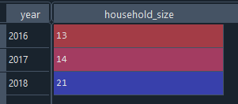
Group By: Example 1
res=data.groupby("year").agg({"household_size":"max"})

Slide 108
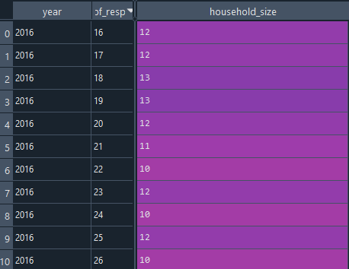
Group By: Example 2
res=data.groupby(["year","age_of_respondent"]).agg({"household_size":"max"},{"age_of_respondent":"mean"})

Slide 109
Group By: Example 3
res=data.groupby(["year","age_of_respondent"])["household_size"].count()

Slide 110
Group By: Example 4
res=data.groupby("year")["age_of_respondent"].count()

Slide 111
Group By : Example 5
res=data.groupby(["year","age_of_respondent"], sort=False).agg({"household_size":"max"},{"age_of_respondent":"mean"})

Slide 112
# Write to files
# Write to files
DataCopy = data.loc[:,:]
DataCopy.to_csv(‘data2.csv', index=False)

Slide 113
Pandas Merge DataFrames on Multiple Columns
# Merge default pandas DataFrame without any key column
merged_df = pd.merge(df,df1)
df.merge(data_2, on='column_name', how='left')

Slide 114
Missing Data
#check to see if any values are null, which there are not
print(data.isnull().values.any())
#Drop rows that contain less than 5 non-missing values
data. dropna(thresh = 5)
# Replace missing values with zeros
fillna(0)
# Replace missing values with Mean
data.fillna(data.mean())
for i in df.columns[df.isnull().any(axis=0)]: #---Applying Only on variables with NaN values
df[i].fillna(df[i].mean(),inplace=True)

Slide 115
Numpy

Slide 116
Python Libraries for Data Science (or Scientific Python packages)
Many popular Python toolboxes/libraries:
Numerical
○ NumPy
○ SciPy
○ Pandas
Machine Learning
○ SciKit-Learn
Visualization libraries (Graphics)
○ matplotlib
○ Seaborn
and many more …
Databases
○ pyodbc
○ psycopg2 PosgreSQL
○ MySQLdb MySQL
○ cx_oracle Oracle
○ ibm_db
○ pymssql SQL Server
Link: http://www.numpy.org/
Link: https://www.scipy.org/scipylib/
Link: http://scikit-learn.org/
Link: https://seaborn.pydata.org/
Link: https://matplotlib.org/

Slide 117
Python Libraries for Data Science
NumPy:
introduces objects for multidimensional arrays and matrices, as well as functions that allow to easily perform advanced mathematical and statistical operations on those objects
provides vectorization of mathematical operations on arrays and matrices which significantly improves the performance
many other python libraries are built on NumPy

Slide 118
Creating array
import numpy as np
zeros(n)
zeros((n,m))
ones(n)
ones(n,m)
empty (n)
v1 = np.
eye(n)
np.array[[x,..,x],[],[]]
genfromtxt('matrix.txt')
random.uniform(VI, VF, (n, m))
np.arange(vi, vf, step)
arr = df.to_numpy()
np.linspace(first, last, nb-elt)

Slide 119
Creating array I
convention
import numpy as np
create 3-element array, all 0.0
v1 = np.zeros(3)
v2 = np.ones(3)
v3 = np.empty(3)
create 3-element array, all 1.0
Default type: np.float ≡ double precision
create 3-element "empty" array initialize elements later
create 2 × 3 array, all elements 0.0
a = np.zeros((2, 3))
b = np.ones((2, 3))
c = np.eye(2)
d = np.empty((2, 3))
v1 = np.zeros(3, dtype=np.int8)
create 2 × 3 array, all elements 1.0
create 2 × 2 identity array
create 2 × 3 "empty" array initialize elements later

Slide 120
Creating arrays II
e = np.random.uniform(0.0, 1.0, (2, 3))
create 2 × 3 array, elements x randomly drawn from uniform distribution such that x ∈ [0.0, 1.0[
f = np.array([[3.1, 4.2, -1.1], [-0.3, 1.3, 13.1]])
create 2 × 3 array from a Python list of lists
f = np.genfromtxt('matrix.txt')
create 2 × 3 array from text file
1.2 2.3 3.4
4.5 5.6 6.7

Slide 121
Creating arrays III
e = np.arange(-1.0, 1.0, 0.25)
create 8-element array, first element -1.0,
last element less than 1.0, step 0.25
[ -1. -0.75 -0.5 -0.25 0. 0.25 0.5 0.75 ]
f = np.linspace(-1.0, 1.0, 9)
create 9-element array, first element -1.0,
last element 1.0, determine step
[ -1. -0.75 -0.5 -0.25 0. 0.25 0.5 0.75 1. ]

Slide 122
Convert Pandas DataFrame To Numpy Arrays
import pandas as pd
df = pd.read_csv('datasets.csv')
# Convert DataFrame to numpy array
arr = df.to_numpy()

Slide 123
Numpy data types
Integers np.int8, np.int16, np.int32, np.int64 default for np.int: np.int32 on 32-bit, np.int64 on 64-bit architecture (np.uint<n> for unsigned integers)
Floating point numbers np.float16, p.float32, np.float64, np.float96 default for np.float: np.float64, i.e., double precision
Complex numbers np.complex64, np.complex128, np.complex192 default for np.complex: np.complex128, i.e., double precision
Boolean values: np.bool
Characters/strings: np.character
v = np.zeros(3, dtype=np.int8)

Slide 124
Accessing array elements
import numpy as np
A = np.array([[1, 4, 5, 12],
[-5, 8, 9, 0],
[-6, 7, 11, 19]])
# First element of first row
print("A[0][0] =", A[0][0])
# Third element of second row
print("A[1][2] =", A[1][2])
# Last element of last row
print("A[-1][-1] =", A[-1][-1])
A[0][0] = 1
A[1][2] = 9
A[-1][-1] = 19

Slide 125
Accessing array elements
import numpy as np
A = np.array([[1, 4, 5, 12],
[-5, 8, 9, 0],
[-6, 7, 11, 19]])
print("A[0] =", A[0]) # First Row
print("A[2] =", A[2]) # Third Row
print("A[-1] =", A[-1]) # Last Row (3rd row in this case)
A[0] = [1, 4, 5, 12]
A[2] = [-6, 7, 11, 19]
A[-1] = [-6, 7, 11, 19]

Slide 126

Exercice
Transpose a matrix using NumPy in Python:
You can use the function np.transpose but how does it work ?

Slide 127


Exercice
Write a Python function named matrix_addition that takes two matrices as input (represented as nested lists) and returns the result of their addition.

Slide 128

Accessing array elements
a = np.zeros((2, 3))
nr. bytes to next row
Array dimensions, strides
Assigning to a specific element
Using an element's value
a.shape == (2, 3)
a.strides == (24, 8)
nr. bytes to next column
a[1, 0] = 5.0
$$\left(\begin{matrix}0.0 & 0.0 & 0.0 \\ 5.0 & 0.0 & 0.0\end{matrix}\right)$$
Note:
Implicit conversion of tuple for indexing
0-based indexing
q = a[1, 0] + a[1, 2]

Slide 129
Accessing subarrays: slicing
[[ 1 2 3 4 5 ]
[ 6 7 8 9 10 ]
[ 11 12 13 14 15 ]
[ 16 17 18 19 20 ]]
a = np.arange(1, 21).reshape(4, 5)
Second column
Third row
2D subarray
a[:, 1]
[ 2 7 12 17 ]
result: 1D array
a[2, :]
[ 11 12 13 14 15 ]
[[ 1 2 3 4 5 ]
[ 6 1 0 9 10 ]
[ 11 0 1 14 15 ]
[ 16 17 18 19 20 ]]
a[1:3, 1:3] = np.eye(2)
cfr. list slicing, but…
array slicing does not copy!
Notes:
Reshape (riychaype)

Slide 130
indexing
a = np.arange(1, 10, dtype=np.int).reshape(3, 3)
[[ 1 2 3 ]
[ 4 5 6 ] [ 7 8 9 ]]
Conditional indexing
Conditional assignment
a[a % 2 == 1] = 0
[[ 0 2 0 ]
[ 4 0 6 ] [ 0 8 0 ]]
3 × 3 Boolean array
np.where(a > 0, 1, -1)
[[ -1 1 -1 ]
[ 1 -1 1 ] [ -1 1 -1 ]]
3 × 3 Boolean array

Slide 131
Operations on arrays
Scalar-array operations: +, -, *, /, //, **
Element-wise operations: +, -, *, /, //, **
Matrix product
a = np.array([[1.0, 3.0], [4.0, 5.0]])
print(3.0 + a)
[[ 4. 6. ]
[ 7. 8. ]]
a = np.array([[1.0, 3.0], [4.0, 5.0]])
b = np.array([[2.0, 3.0], [1.0, 0.5]])
print(a*b)
[[ 2. 9. ]
[ 4. 2.5 ]]
print(np.dot(a, b))
[[ 5. 4.5 ]
[ 13. 14.5 ]]

Slide 132
Functions operating on arrays
a = np.empty((500, 500))
b = np.random.uniform(0.0, 1.0, (500, 500))
Avoid
Other functions: np.sin, …, np.sinh, …, np.exp, np.trace, np.transpose,…
for i in range(500):
for j in range(500):
a[i, j] = math.sqrt(b[i, j])

Slide 133

Exercice
You can use the function np.matmul but how does it work ?

Slide 134
Some linear algebra
a = np.array([[1.0, 3.0], [4.0, 5.0]])
numpy has some linear algebra operations
matrix power
matrix inverse
determinant
eigen values
[[ 85. 129.]
[ 172. 257.]]
np.linalg.matrix_power(a, 3)
[[-0.71428571 0.42857143]
[ 0.57142857 -0.14285714]]
np.linalg.inv(a)
np.linalg.det(a)
-7.0
np.linalg.eigvals(a)
[-1. 7.]
Notes:
valeurs propres=eigen values

Slide 135



Exercice: La régression linéaire multiple
Notation matricielle

Slide 136







Exercice: La régression linéaire multiple
np.matmul(a1, a2)
np.transpose (a)
np.linalg.inv(a)

Slide 137
References versus copies
Reshape: different view on same data
Some operations return copies, check documentation carefully
a = np.array([[1.0, 3.0],
[4.0, 5.0]])
[[ 1. 3.]
[ 4. 5.]]
b = a.reshape((a.size, ))
[ 1. 3. 4. 5.]
a[0, 0] = 13.0
[[ 13. 3.]
[ 4. 5.]]
a
b
[ 13. 3. 4. 5.]

Slide 138
Mathplotlib

Slide 139
Python Libraries for Data Science (or Scientific Python packages)
Many popular Python toolboxes/libraries:
Numerical
○ NumPy
○ SciPy
○ Pandas
Machine Learning
○ SciKit-Learn (sklearn)
Visualization libraries (Graphics)
○ matplotlib
○ Seaborn
and many more …
Databases
○ pyodbc
○ psycopg2 PosgreSQL
○ MySQLdb MySQL
○ cx_oracle Oracle
○ ibm_db
○ pymssql SQL Server
Link: http://www.numpy.org/
Link: https://www.scipy.org/scipylib/
Link: http://scikit-learn.org/
Link: https://seaborn.pydata.org/
Link: https://matplotlib.org/

Slide 140
Visualization

Slide 141

Visualization

Slide 142

Visualization

Slide 143

Visualization

Slide 144
Python Libraries for Data Science
matplotlib:
python 2D plotting library which produces publication quality figures in a variety of hardcopy formats
a set of functionalities similar to those of MATLAB
line plots, scatter plots, barcharts, histograms, pie charts etc.
relatively low-level; some effort needed to create advanced visualization
Link: https://matplotlib.org/

Slide 145
Matplotlib
Matplotlib is one of the most powerful tools for data visualization in Python.
Matplotlib is an incredibly powerful (and beautiful!) 2-D/ 3-D plotting library.
It is easy to use and provides a huge number of examples for tackling unique problems
In order to get matplotlib into your script,
first you need to import it, for example:
import matplotlib.pyplot as plt
However, if it is not installed, you may need to install it:
Easiest way to install matplotlib is using pip.
Type the following command in the command prompt (cmd) or your Linux shell;
pip install matplotlib
Note that you may need to run the above cmd as an administrator

Slide 146
Matplotlib
Strives to emulate MATLAB
matplotlib.pyplot is a collection of command style functions that make matplotlib work like MATLAB.
Each pyplot function makes some change to the figure:
e.g.,
creates a figure,
creates a plotting area in the figure,
plots some lines in the plotting area,
decorates the plot with labels, etc.
Note that various states are preserved across function calls
Whenever you plot with matplotlib, the two main code lines should be considered:
Type of graph
this is where you define a bar chart, line chart, etc.
Show the graph
this is to display the graph

Slide 147







E.g. Matplotlib
Matplotlib allows you to make easy things
You can generate plots, histograms, power spectra, bar charts, errorcharts, scatterplots, etc., with just a few lines of code.

Slide 148





E.g. Matplotlib

Slide 149
# plotting the points
plt.plot(x, y, color='green', linestyle='dashed', linewidth = 3,
marker='o', markerfacecolor='blue', markersize=12)
# setting x and y axis range
plt.ylim(1,8)
plt.xlim(1,8)
# naming the x axis
plt.xlabel('x - axis')
# naming the y axis
plt.ylabel('y - axis')
# giving a title to my graph
plt.title('Some cool customizations!')
import matplotlib.pyplot as plt
xs = [1,2,3,4,5]
y = [x**2 for x in xs]
plt.plot(xs, y)
plt.show()

Slide 150
import matplotlib.pyplot as plt
xs = [1,2,3,4,5]
ys = [x**2 for x in xs]
plt.plot(xs, ys)
plt.show()
import matplotlib.pyplot as plt
#Create data for plotting
values = [5, 6, 3, 7, 2]
names = ["A", "B", "C", "D", "E"]
plt.bar(names, values, color="green")
plt.show()
import matplotlib.pyplot as plt
#Create data for plotting values = [5,6,3,7,2] names = ["A", "B", "C", "D", "E"]
# Adding an "h" after bar will flip the graph plt.barh(names, values, color="yellowgreen") plt.show()
import matplotlib.pyplot as plt
#generate fake data
x = [2,1,6,4,2,4,8,9,4,2,4,10,6,4,5,7,7,3,2,7,5,3,5,9,2,1]
#plot for a histogram
plt.hist(x, bins = 10, color='blue', alpha=0.5)
plt.show()
import matplotlib.pyplot as plt
x = [1,2,3,4,5,6,7,8,9,10]
y = [2,4,5,7,6,8,9,11,12,12]
plt.scatter(x, y, label= "stars", color="green", marker="*", s=30)
plt.xlabel('x - axis')
plt.ylabel('y - axis')
plt.title('My scatter plot!')
plt.legend()
plt.show()
import matplotlib.pyplot as plt values = [5,6,3,7,2] lab = ["A", "B", "C", "D", "E"]
plt.pie(values, labels = lab , autopct = '%1.1f%%') plt.show()

Slide 151
Customization of Plots
import matplotlib.pyplot as plt
# x axis values
x = [1,2,3,4,5,6]
# corresponding y axis values
y = [2,4,1,5,2,6]
# plotting the points
plt.plot(x, y, color='green', linestyle='dashed', linewidth = 3,
marker='o', markerfacecolor='blue', markersize=12)
# setting x and y axis range
plt.ylim(1,8)
plt.xlim(1,8)
# naming the x axis
plt.xlabel('x - axis')
# naming the y axis
plt.ylabel('y - axis')
# giving a title to my graph
plt.title('Some cool customizations!')
# function to show the plot
plt.show()

Slide 152

Plot
We can group these options into functions as usual, but remember that they are operating on a global, hidden variable

Slide 153

Boxplots

Slide 154

Boxplots

Slide 155

Boxplots
import matplotlib.pyplot as plt
import numpy as np
x1 = np.linspace(0, 20, 140)
x1 = np.random.randint(1, 20, size=(140))
fig, ax = plt.subplots()
ax.boxplot([x1, x2])
plt.show()

Slide 156
Correlation matrix

Slide 158
Data Preparation Steps Feature Engineering Methods

Slide 159
Feature engineering methods

Slide 160

Imputation

Slide 161

Imputation

Slide 162
Missing Values
Unavailability of data or data not recorded
Randomly missing data Appearance
Missing data in a dataset may be in the form of:
‘NA’
‘ ‘ - Blank
In R, all blank spaces are to be converted as ‘NA’ before they are treated

Slide 163

Missing Values

Slide 164
Imputation
If one column or a few columns in a row have missing data there are two ways of handling it:
Delete the row :
Data is a valuable resource. One need to salvage data as far as possible instead of deleting it. However if any row or columns has many missing values, it may be wise to delete it.
Replace the missing data with a likely data value – Imputation

Slide 165
Typical simple methods of imputation
Continuous data
Replace with the mean (or sample mean) or median or mode value of the data in the column. Mean is commonly used
Treat the column with missing value as the dependent value and use all other columns as independent variables and perform “prediction” (Ex: Linear regression, random forest) to predict the missing value
Categorical data
Use the most frequent category in the column as a replacement
KNN method to predict missing value
Use any other classifier to predict the missing value (Ex: logistic regression, random forest)

Slide 166
Missing Values
There are a number of methods to deal with missing values in the data frame:
df.method() | description
dropna() | Drop missing observations
dropna(how='all') | Drop observations where all cells is NA
dropna(axis=1, how='all') | Drop column if all the values are missing
dropna(thresh = 5) | Drop rows that contain less than 5 non-missing values
fillna(0) | Replace missing values with zeros
isnull() | returns True if the value is missing
notnull() | Returns True for non-missing values

Slide 167
Checking if there are NAs
Il existe des valeurs nulls:
df.isnull().values.any() # bool
Quels sont les colonnes
df.isnull().any() # series
Number of missing values in each column
missing_values= pd.DataFrame(df.isnull().sum(), columns=['Missing Values’])
Detecting the NAN values indexes
missing=data[df.isnull().any(axis=1)]

Slide 168
fill missing Values
Apple
Group
Mango
Group

Slide 169
fill missing Values
# Data filling
df['column_name'].fillna('some_values’)
DataFrame.fillna(values, inplace=False)
Notes:
Fill-anay (fill)

Slide 170
fill missing Values
Fill with Constant Value
df['price'].fillna(value = 0.85, inplace = True)
Fill with Mean / Median of Column
# mean
df['price'].fillna(value = df.price.mean(), inplace = True)
# median
df['price'].fillna(value = df.price.median(), inplace = True)

Slide 171
fill missing Values (Fillna (Fill NA/NaN))
# fill missing values
df['Postal Address'].fillna(df['Permanent Address'], inplace=True)
print(df)

Slide 172
Duplicate Values
# Drop duplicates
df.drop_duplicates()
# Delete a column
del df['column_name']
df.drop('column_name', axis=1)
pop('column_name')

Slide 173

Outliers

Slide 174

Outlier detection

Slide 175

Finding Outliers

Slide 176

Finding Outliers using Box plot

Slide 177

Finding Outliers using Box plot

Slide 178


Finding Outliers using Box plot
Mediane : divise les données en deux partie egaux

Slide 179

Finding Outliers using Box plot
• Above plot shows three points between 10 to 12, these are outliers as there are not included in the box of other observation i.e no where near the quartiles.
• Here we analysed Uni-variate outlier i.e. we used DIS column only to check the outlier.
• We can do multivariate outlier analysis too. Can we do the multivariate analysis with Box plot? Well it depends, if you have a categorical values then you can use that with any continuous variable and do multivariate outlier analysis

Slide 180
Example

Slide 181
Example
import random
import pandas as pd
import numpy as np
import plotly.express as px
import seaborn as sns
random.normalvariate(5,1)
arr_norm = np.random.normal(10, 2, 50000)
)
Moyenne a:=10
Ecart type = 2
Nbr effective= 50 000

Slide 182

Example
import random
import pandas as pd
import numpy as np
import plotly.express as px
import seaborn as sns
random.normalvariate(5,1)
arr_norm = np.random.normal(10, 2, 50000)
ser= pd.Series(arr_norm)
ser.describe()
print(ser.describe())

Slide 183

Example
import random
import pandas as pd
import numpy as np
import plotly.express as px
import seaborn as sns
random.normalvariate(5,1)
arr_norm = np.random.normal(10, 2, 50000)
ser= pd.Series(arr_norm)
ser.describe()
print(ser.describe())
px.box(arr_norm)
sns.boxplot(arr_norm)
Notes:
Dans la Distribution normal, la moyenne et le mediane c la meme valeur
Premier Q1:
50% de valeur sont la
La distribution entre la mediale et
labonrne hauteet la borne basse
c’est la meme
Veleur min, veleur max
Distribution
La distribution autour de la mediabe est parfaite
La mediane est centré
La distributon autour de la moyenne est symetrique

Slide 184

Box plot visualization with Pandas and Seaborn
import pandas as pd
#create DataFrame
df = pd.DataFrame({'points': [4, 4, 7, 8, 12, 13, 15, 18, 22, 23, 23, 25],
'assists': [2, 5, 4, 7, 7, 8, 5, 4, 5, 11, 13, 8],
'sex': ['M', 'F', 'M', 'F', 'F', 'M', 'M', 'F', 'F', 'F', 'M', 'M'],
'rebounds': [7, 7, 4, 6, 3, 8, 9, 9, 12, 11, 8, 9]})
#view DataFrame
print(df)
df.boxplot(by ='sex', column =['assists'], grid = False)

Slide 185

Boxplot of Multiple Columns of a Pandas Dataframe on the Same Figure (seaborn)
import random
import pandas as pd
import numpy as np
df = pd.DataFrame(data = np.random.random(size=(4,4)), columns = ['A','B','C','D'])
df.boxplot()
Not symetric
symetric

Slide 186


Normal distribution
import numpy as np
import matplotlib.pyplot as plt
from scipy.stats import norm
import statistics
# Plot between -20 and 20 with .001 steps.
x_axis = np.arange(-20, 20, 0.01)
# Calculating mean and standard deviation
mean = statistics.mean(x_axis)
sd = statistics.stdev(x_axis)
plt.plot(x_axis, norm.pdf(x_axis, mean, sd))
plt.show()
Mois de chance de sortir 15
Il ya plus de chance de sortir 5

Slide 187
Finding Outliers

Slide 188

Finding Outliers using Scatter plot

Slide 189


Finding Outliers using Scatter plot
• We can try and draw scatter plot for two variables from our dataset.

Slide 190

Finding Outliers using Scatter plot
Looking at the plot above, we can most of data points are lying bottom left side but there are points which are far from the population like top right corner

Slide 191
Finding Outliers using Scatter plot
Looking at the plot above, we can most of data points are lying bottom side but there are points which are far from the population like top right corner

Slide 192
Removing Indexes with Outlier Values

Slide 193
How to plot a scatter plot with matplotlib?
plt.scatter(x = dataframe.index, y = dataframe.value)
import matplotlib.pyplot as plt
data = pd.read_csv("Data.csv")
plt.scatter(data.index, data.household_size)
plt.xlabel("index")
plt.ylabel("household_size")
plt.show()

Slide 194

Finding Outliers using standard deviation (SD)

Slide 195

Finding Outliers using standard deviation (SD)

Slide 196
Feature engineering methods

Slide 197

Feature Encoding

Slide 198
Types de variables
Numériques
(Poids, Taille, …)
Binaires
Catégoriques
(Couleur, Situation familiale, …)
Ordinales
(Résultat d’un concours, Qualité d’un produit, …)

Slide 199

Transformer les données
Le Codage doit preserver les relations
Codage Binaire: 0,1
Sexe : M-F
Codage simple : 1,2,3  L’ordre est important ??
Taille internationale, XXS, XS, S, S/M, M, M/L
risk levels: High, Medium and Low.
One hot encoding is a binary representation of a categorical data

Slide 200

Feature Encoding

Slide 201

One Hot Encoding

Slide 202
How do I provide accurate data? Data Transformation

Slide 203
Feature engineering methods

Slide 204
How do I unify and scale data? Data Normalization

Slide 205

Scaling

Slide 206

Normalization

Slide 207

Normalization

Slide 208

Standardization

Slide 209

Standardization

Slide 210
Data Normalization
Scaling
Min-Max Scaling-
Standardization/Variance Scaling-

Slide 211
Scaling
The most popular scaling techniques include:
min-max scaling
absolute maximum
Standardization
normalization

Slide 212

Standardization (Variance Scaling)

Slide 213

Min-Max Scaling

Slide 214

Why Scaling?

Slide 215
Normalisation des variables continues
X’i sont entre 0 et 1
X’i = 0 si xi=min xj
X’i = 1 si xi=max xj

Slide 216
Exercice
Normaliser les variables suivantes :

Slide 217
Normalisation des variables continues
x
−
min
x
x
'
=
i
i
i
max
x
−
min
x
i
i

Slide 218
Une autre fonction de normalisation
Calculer l’écart absolu moyen:
où
Calculer la mesure standardisée (z-score)

Slide 219
Exercice
Normaliser les variables suivantes :

Slide 220
Exemple

Slide 221
Features Selection Methods

Slide 222
Principal Component Analysis (PCA):
import pandas as pd
import numpy as np
from sklearn.decomposition import PCA
# Read the data from the CSV file into a pandas DataFrame
data = pd.read_csv('data.csv')
# Separate the features (X) from the target variable if you have one
# For PCA, we only need the features (X)
X = data.drop(columns=['target_column']) # Replace 'target_column' with your target column name if applicable
# Display the data before PCA
print("Data Before PCA:")
print(X)
# Create a PCA object with the desired number of components for feature reduction
num_components = 2
pca = PCA(n_components=num_components)
# Fit the PCA model to the data and transform the data to the new feature space
X_reduced = pca.fit_transform(X)
# Access the principal components (feature vectors)
components = pca.components_
# Access the explained variance ratio (percentage of variance explained by each component)
explained_variance_ratio = pca.explained_variance_ratio_
# Display the data after PCA
print("\nData After PCA:")
print(pd.DataFrame(X_reduced, columns=[f"PC{i+1}" for i in range(num_components)]))

Slide 223
Steps in a machine learning pipeline
Data Modeling/eval
Test Data
Model Requirement
Raw data
Data
Pre processing
Training
Data
Identify a problem
Defining the objective
Determine the type of data
Set a plan for collecting the data
Decide data sources
Select collection methods
Develop data collection instruments
Requirements
Analysis
Data
Acquisition
Predictive Modeling
Evaluation
Deployment
Roles
Data Scientist
Domain Expert
(Data) Engineer

Slide 224
Python Libraries for Data Science (or Scientific Python packages)
Many popular Python toolboxes/libraries:
Numerical
○ NumPy
○ SciPy
○ Pandas
Machine Learning
○ SciKit-Learn (sklearn)
Visualization libraries (Graphics)
○ matplotlib
○ Seaborn
and many more …
Databases
○ pyodbc
○ psycopg2 PosgreSQL
○ MySQLdb MySQL
○ cx_oracle Oracle
○ ibm_db
○ pymssql SQL Server
Link: http://www.numpy.org/
Link: https://www.scipy.org/scipylib/
Link: http://scikit-learn.org/
Link: https://seaborn.pydata.org/
Link: https://matplotlib.org/

Slide 225
The ideal tool for data scientists
managing data
Cleaning data
Analyzing data
Modeling data
Organizing the results of the analysis into a form suitable for plotting or tabular display

Slide 226
SciKit-Learn:
SciKit-Learn (sklearn)
provides machine learning algorithms: classification, regression, clustering, model validation etc.
built on NumPy, SciPy and matplotlib
Machine learning module
Open-source
Built-in datasets
Good resources for learning

Slide 227

Machine Learning

Slide 228
ML (Data Driven) Exemple
Une fonction h aussi proche que possible de f (réalité) où f(x_{i}) = y_{i}
0
0
1
1
h(x) = x³
4
64
5
125
Dans un jeu de cartes:
les cartes gagnantes sont: 9♥, Roi ♥ et 7♦.
les cartes perdantes sont: 3♠, 4♣ et 6♣.
Les cartes rouges sont gagnantes et les cartes numériques noires sont perdantes

Slide 229

Example de dataset

Slide 230

Data splitting
fit(x_train, y-train)
predict(x_test)

Slide 231
Fit and predict
All models (Classification and regression) implement at least two functions:
fit(x, y) - Fit the model to the given dataset
predict(x) - Predict the y values associated with the x values
Transformers (Scaling, etc) implement at least two functions:
fit(x) - Fit the transforms to an initial dataset
transform(x) - Transform the given data based on the initial fitted data

Slide 232
The different types of classifiers
Naive Bayes.
Decision Tree.
Logistic Regression.
K-Nearest Neighbor.
Artificial Neural Networks/Deep Learning.
Support Vector Machine.

Slide 233


Scikit-learn
Example of Classification

Slide 234

Scikit-learn
Example of Classification

Slide 235

Cross validation

Slide 236

Cross validation

Slide 237
Our Lab

Slide 238
Import Package
import pandas as pd
import numpy as np
import matplotlib.pyplot
import seaborn as sns

Slide 239
Read Data
data = pd.read_csv('Wine.csv')

Slide 240
About Data
data.shape

Slide 241
About Data..
data.head()

Slide 242
Data statistics
data.describe()

Slide 243
The distinct values of the output (label)
data.Customer_Segment.unique()

Slide 244
Check data balancing
sns.countplot(data.Customer_Segment)

Slide 245
Data splitting

Slide 246
Data splitting
from sklearn.model_selection import train_test_split
X = data.drop(['Customer_Segment'] , axis = 1)
y = data.Customer_Segment
x_train, x_test, y_train, y_test = train_test_split(X, y, test_size = 0.2)

Slide 247
Now we specify the model type

Slide 248

Import classification model
from sklearn.tree import DecisionTreeClassifier
clf = DecisionTreeClassifier(max_depth = 7)

Slide 249
Model fitting in Python
clf.fit(x_train, y_train)

Slide 250
Use the model for prediction
y_pred = clf.predict(x_test)

Slide 251
Calculation of Accuracy
(y_pred == y_test).mean()
print('The score For Decision Trees: ' , r2_score(y_test , y_pred))
print('The accuracy For Decision Trees is ', (y_pred == y_test).mean())

Slide 252
Confusion matrix
from sklearn.metrics import r2_score
from sklearn.metrics import confusion_matrix
cm = confusion_matrix(y_test, y_pred)
print('Confusion Matrix is :', cm)

Slide 253
Logistic Regression
from sklearn.linear_model import LogisticRegression
clf = LogisticRegression()
clf.fit(x_train, y_train)
y_pred = clf.predict(x_test)
(y_pred == y_test).mean()

Slide 254
SVM (support vector machine)
from sklearn.svm import SVC
clf = SVC(kernel='linear')
clf.fit(x_train, y_train)
y_pred = clf.predict(x_test)
(y_pred == y_test).mean()

Slide 255
Naive Bayes Classifier
from sklearn.naive_bayes import GaussianNB
clf = GaussianNB()
clf.fit(x_train, y_train)
y_pred = clf.predict(x_test)
(y_pred == y_test).mean()

Slide 256
K-nearest neighbors (kNN)
from sklearn.neighbors import KNeighborsClassifier
from sklearn.preprocessing import StandardScaler
std = StandardScaler()
x_train = std.fit_transform(x_train)
x_test = std.fit_transform(x_test)
clf = KNeighborsClassifier()
clf.fit(x_train, y_train)
y_pred = clf.predict(x_test)
(y_pred == y_test).mean()

Slide 257


